Slide 1
Oasis infobyte internship web development and designing
Completed by:
Suraj Agiwale

Slide 2
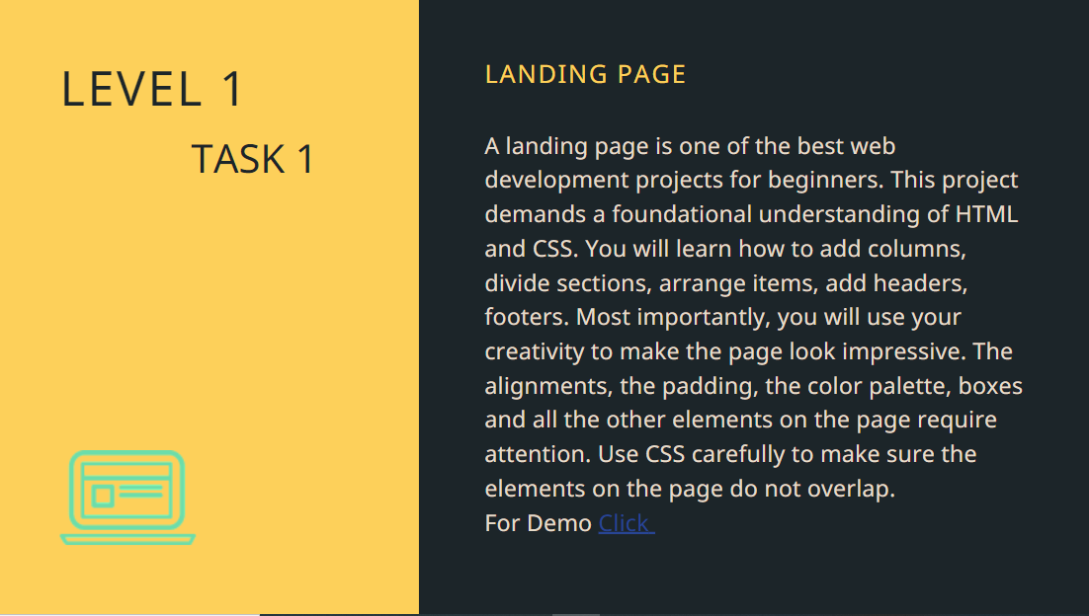

Slide 3
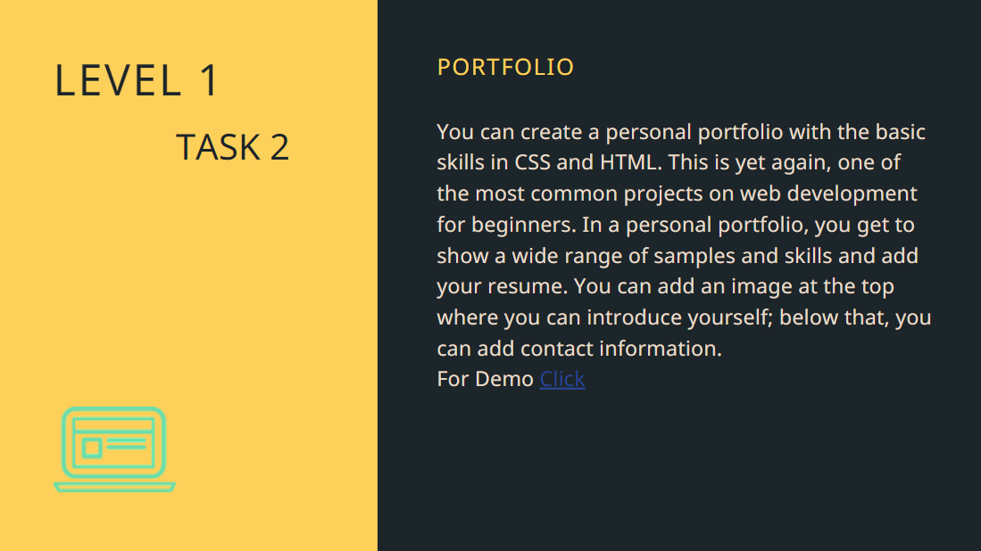

Slide 4
